Slide 1
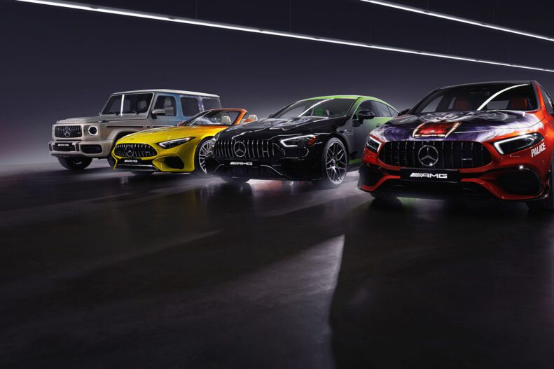
CAR LAUNCH ANALYSIS IN UK MARKET
CAR LAUNCH ANALYSIS IN UK MARKET

Slide 2
a. Create an analysis to find the income class of citizens in UK based on their price.
On the basis of the analysis done,the middle class people are in majority in terms of the total amount spent ,amounting to 57%.
In terms of the frequency of purchases made,the middle class are noticed at 43%.
In terms of the average amount spent,the upper class is noticed to spend the highest at 92,436 pounds.
This infers that the upper class spends on Luxury Cars even if the number of purchases is low,but the middle class purchases more cars but amounting to cheaper brands. The middle class people spend moderately on cars in between luxury and cheap ranges.

Slide 4
b. Categorize the cars on the basis of their price and changes in prices across years and the category with a notable jump in price.
After categorizing the cars into 4 buckets based on price it was found that in case of BMW, category 2 in 2019 has seen the sharpest hike in prices as compared to previous years,hiking by 856127 pounds.
In the case of Hyundai,category 4 saw the most hike of 935588 pounds in 2017.
In the case of Audi,category 2 saw the greatest hike by around 5368107 pounds in 2019.
In the case of Mercedes, category 2 saw the most hike by 8373726 pounds in 2019.

Slide 5
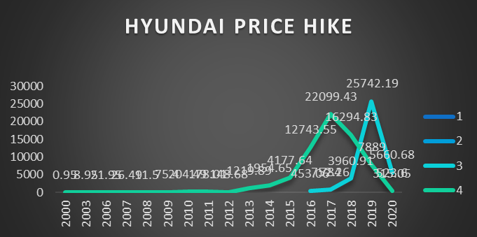
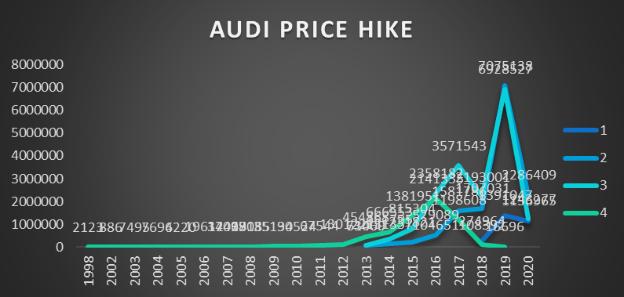
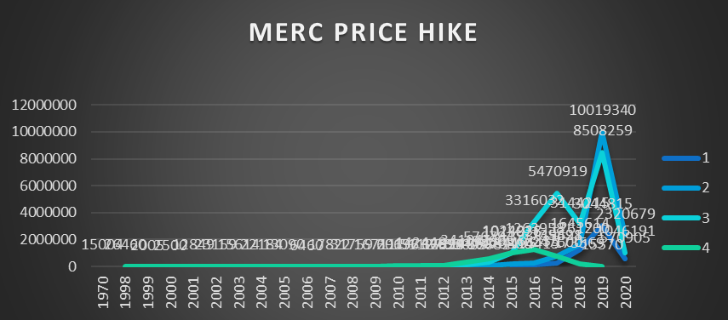

Slide 6
b. changes in no of cars sold across the years and identify the categories which has seen significant jump in its sales .
After categorizing the cars into 4 buckets based on price it was found that in case of BMW, category 3 has seen the sharpest hike in sales as compared to previous years,hiking by 2221 units in 2019.
In the case of Hyundai,category 4 saw the most hike by 457 units in 2017.
In the case of Audi,category 3 saw the greatest hike by 2137 units in 2019.
In the case of Mercedes, category 3 saw the most hike by 2785 units in 2019 .

Slide 7
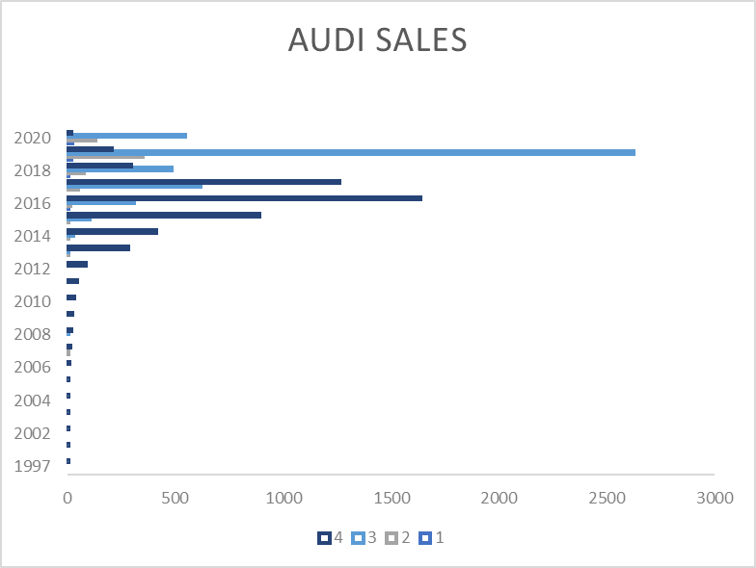
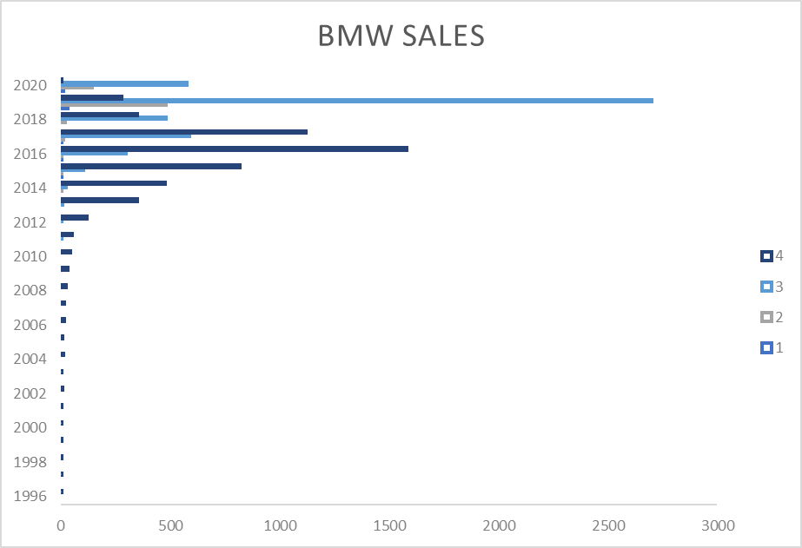
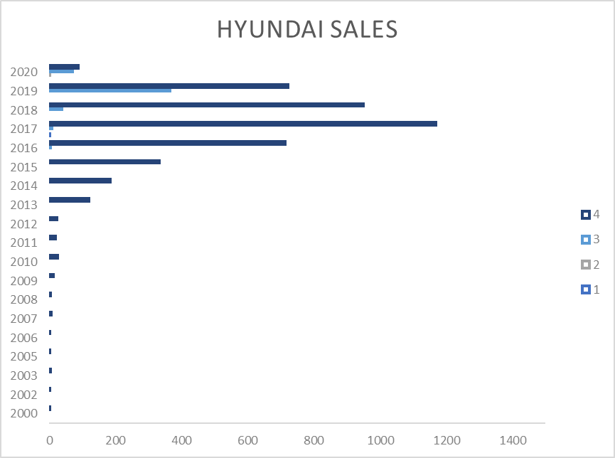
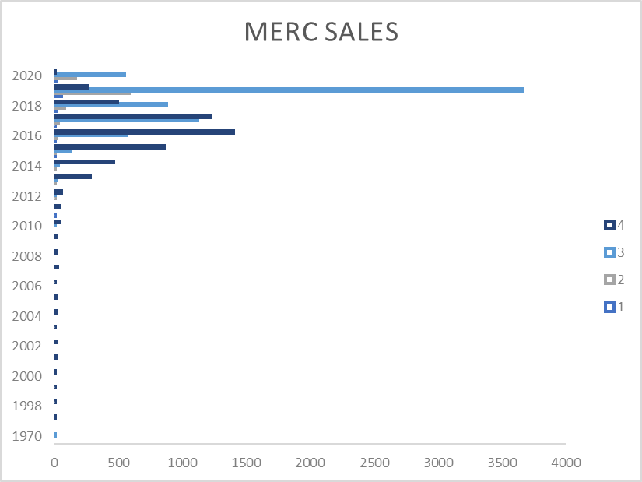

Slide 8
for both points (a) & (b), do a root cause analysis to identify the probable reason for their increase.
In the case of total amounts spent,it has been seen that the upper middle class and upper classes were spending more in terms of the amounts,in case of Audi,BMW and Mercedes are these are luxury cars.All of them were sold in 2019 the most,though fuel prices were high as well,indicating the liking for fuel efficient vehicles which were most present in these categories,like hybrid,electric vehicles.
Hyundai was being bought by people of lower middle classes or maybe of a class lower than them,indicating its affordability,and in such categories which were fuel efficient.

Slide 9
It has been seen that the highest number of sales in the luxury brands are not being done where the mpg is above 67 or 68,rather the prices are much higher, but in the case of Hyundai,the highest number of sales are for the cars at mpg 60, while for BMW, the highest sales are at 64 mpg.
So if at low costs, the mpg is good,then Hyundai looks like an affordable option.
Hyundai has the lowest average car cost of 12750 pounds.

Slide 10
c. Find relationship between fuel efficiency & price of car/sales of car/fuel type/, etc.
The fuel efficiency on analysis can be divided on basis of fuel type and basis of type of automation of car-
The most high range of fuel efficiency which a car gives is that of 134.5 mpg given by automatic,semi automatic and hybrid cars,as they save fuel use but sales are low as they may be expensive to buy.
People in such case prefer moderate efficiency with a relatively lower cost.Like Automatic cars were sold at worth of 7511836 pounds, with efficiency at 57 mpg.
Semi automatic cars were sold at a worth of 11796670, higher than automatic,maybe due to an ease of use,around same mpg.
Manual cars were sold moderately at a worth of 2660834 pounds,with a higher mpg of 68.9.

Slide 11
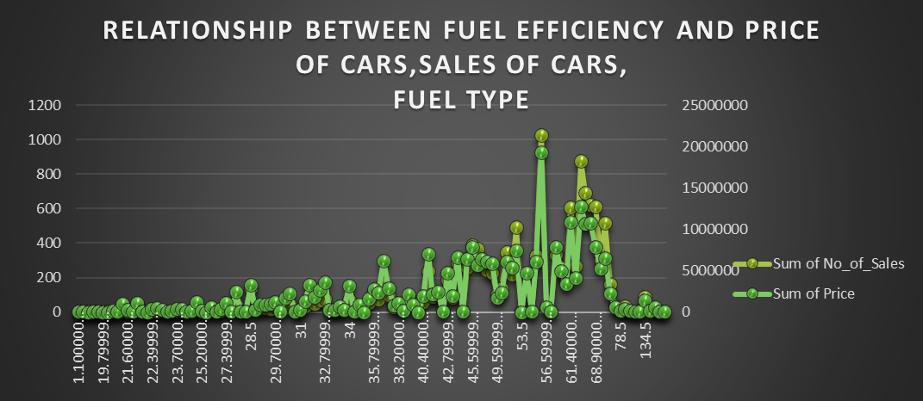

Slide 12
This maybe due to the high price of luxury cars that they purchase.
In case of fuel, hybrid cars were less in market,maybe due to less preference, so people preferred diesel cars which were sold at 1027 units for 19327500 pounds with 55 mpg range
Petrol cars were sold at only 412 units with 53 mpg.
There are still customers who prefer petrol and diesel cars and manual cars as manual cars are more efficient and if less,there isn’t much of mpg difference.

Slide 13
Create an analysis to show the effect of fuel expenditure on the sales of car over the years
Though the fuel prices in 2019 were comparatively higher than the previous years,the sales were also comparitively higher.
In terms of the classes of population,the upper and upper middle classes spent more in terms of average amount,the cars could be automatic ,semi automatic and hybrid too,because of fuel saving.
The middle classes spent more in terms of total amount,they could have bought automatic ,semi automatic and manual too, but those categories which were affordable. The amount of cars purchased were also high,but they would be either not much fuel efficient and of a lower rate. In either of the cases,the sales were high,in terms of amount.

Slide 15
Over the years,say from 2000,the sales were negligible due to the changes in the economy post the global financial crisis.
Post 2000, the decade went into a recovery phase, similar to the phase after 2019,when the Coronavirus pandemic occurred,hence the difference in sales and petrol prices, also in 2019 there was uncertainty due to Brexit and patterns of purchase changed.

Slide 16
Using all of the above analysis, suggest cost and usage effective car type for the brand to launch(We can launch multiple types of car as well)
The ideal car types are those which fulfil 3As- Affordable,Accessible,Available.
Lets analyse those cars which fulfil these 3 As-
In the Category of Audi,model A2 will be suitable because even though it has a slight high price,still it provides a higher efficiency than most models.Customers will prefer this over others.
In the category BMW, i3 will be suitable,because with least amount of difference in price it provides a superior mpg than others.

Slide 17
For Hyundai,Getz will be the most suitable model to be purchased by customers.
For Mercedes, model 180 will be suitable.

Slide 18
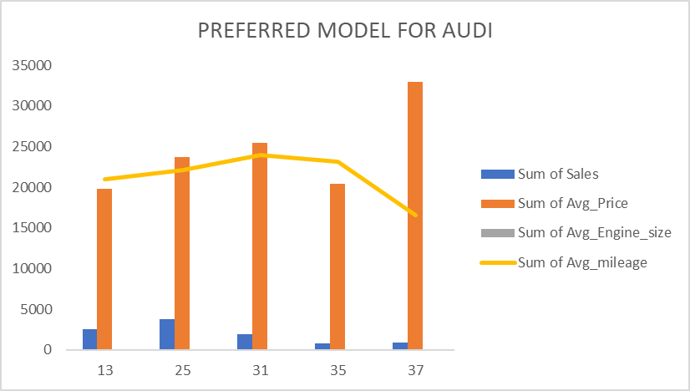
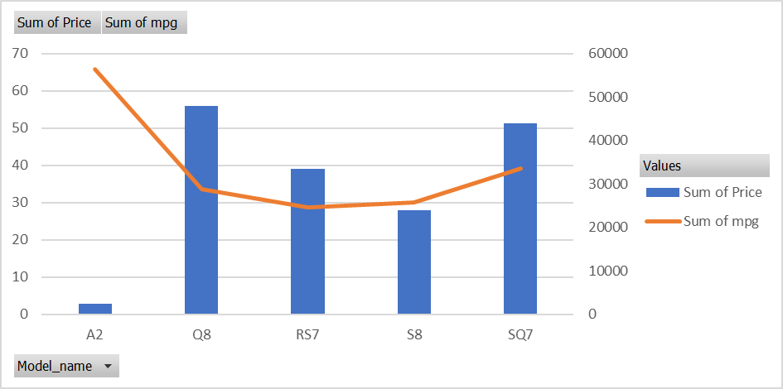
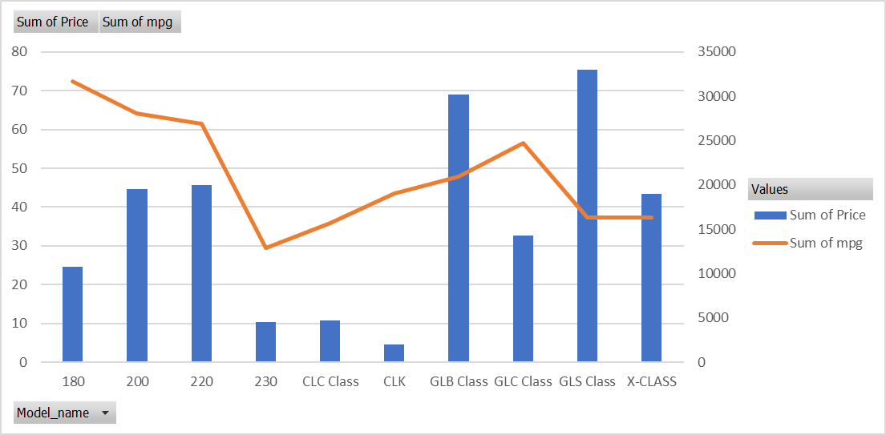
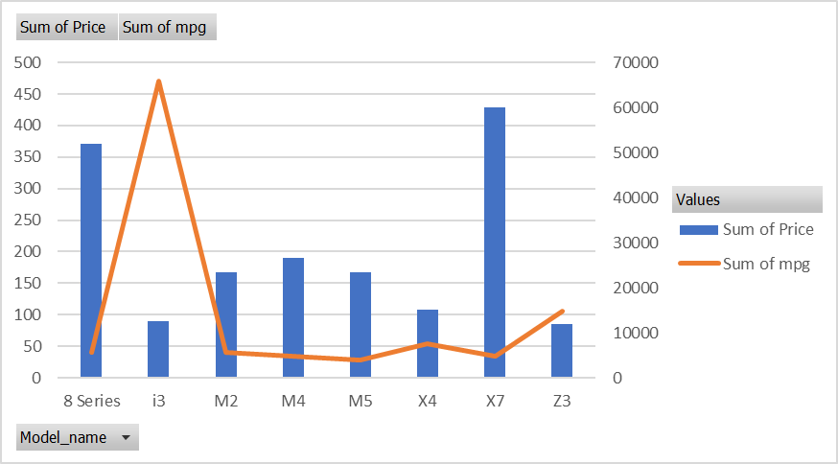

Slide 19
Observe the identified models and provide your inference.
The sales rank 1 with model ID 25 is just good in terms of sales of cars but in terms of mileage it is still not suitable.
On the contrary,model ID 35 is 3000 pounds less than the rank 1 model and is also just 800 points low in terms of mpg while rank 1 model has a 1000 points gap from the highest mileage.
Therefore,it can be concluded that companies must guide their sales with point of view of the class of customers they are catering to and the mechanisms of the car they are selling.

